Slide 1
Samsung
Innovation
Campus
Artificial Intelligence Course

Slide 2
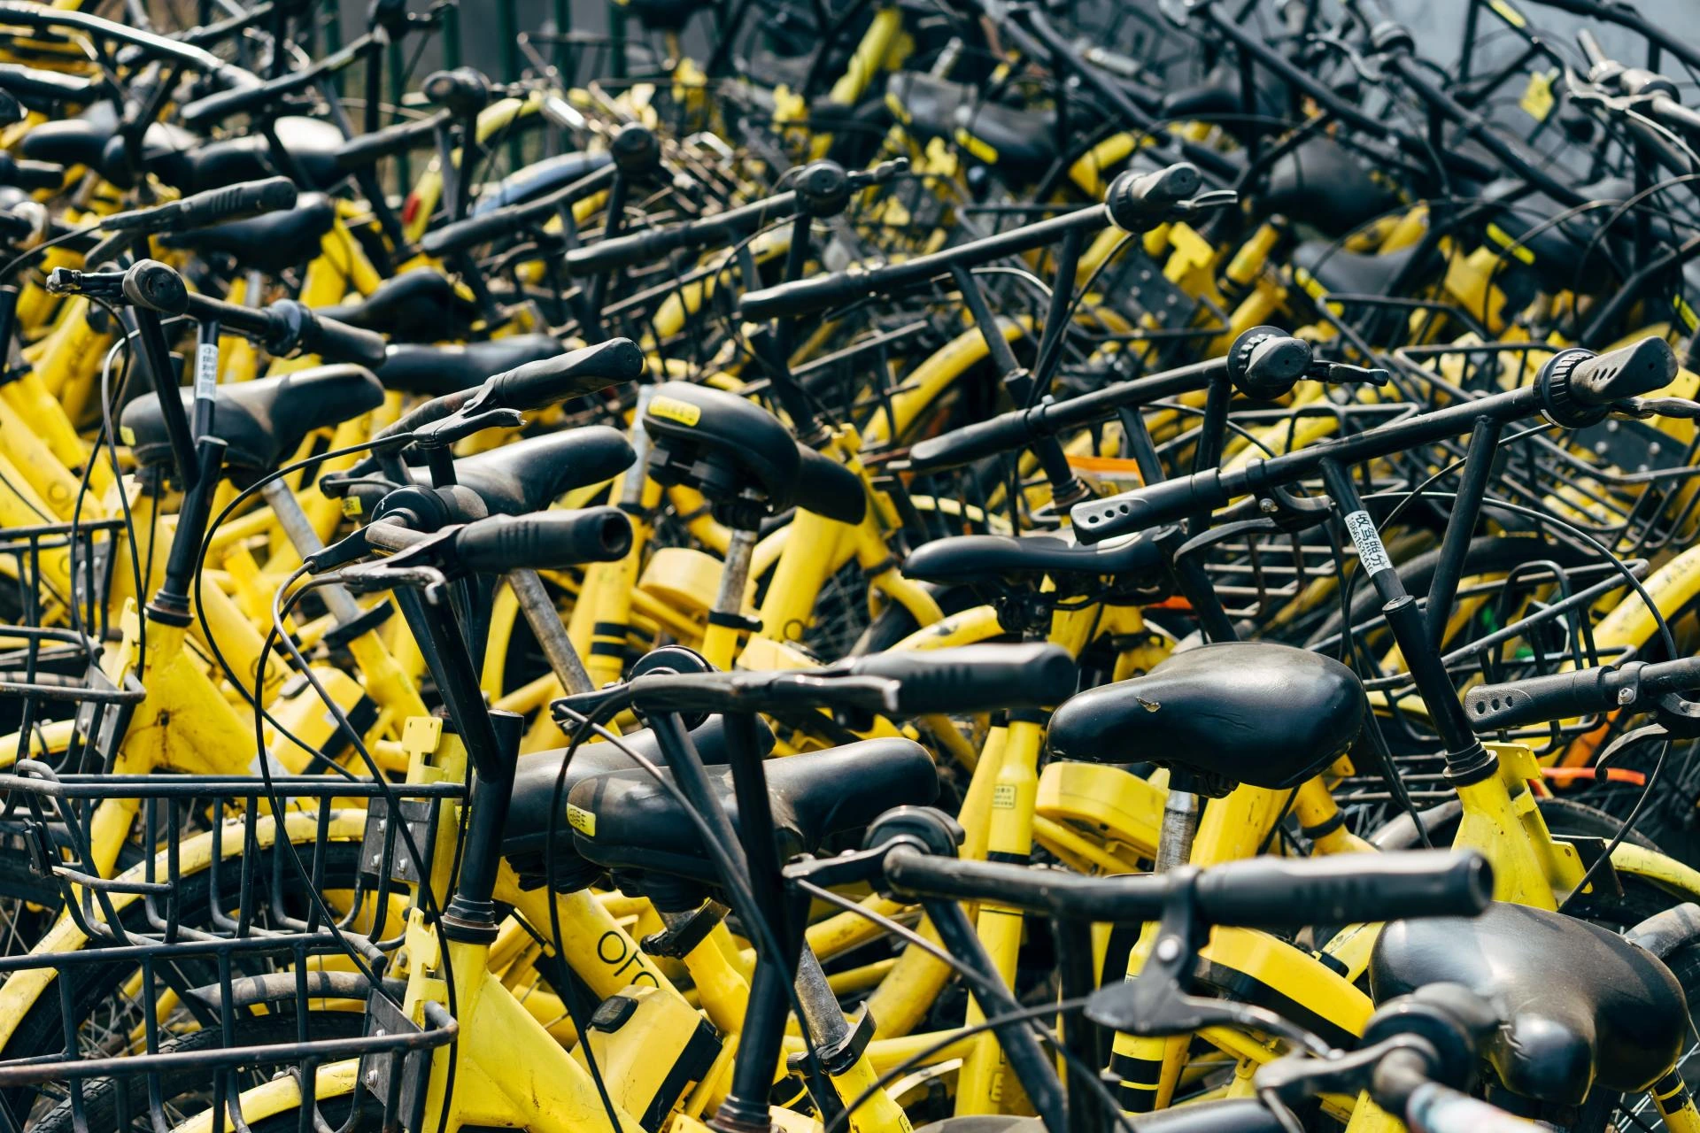

Bike Sharing Demand
Mostafa Sayed
Supervised by:
Eng. Mohamed Abdullah
Dr. Doaa Mahmoud
Data:
Bike Sharing Demand

Slide 3
Agenda
Data Explanation
The Objectives
Data Preparation
Exploratory Data Analysis
Business solutions and recommendations
Data Preprocessing
The Challenges
Modelling

Slide 4
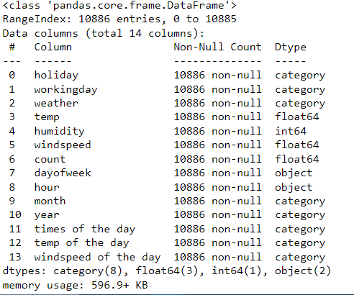
Data Explanation

Slide 5
The Goal
Our main goal is to predict the total count of bikes rented during each hour.
Our secondary goal is increase number of abnormal individuals that share bikes to become normal.
One of other goals is to encourage people who do not cycle to start cycling, shared bikes must be safe and easy to use.

Slide 6
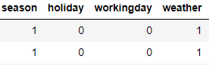
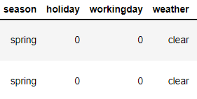
Data Preparation
I mapped the labeled data to its respective values to make it easier for EDA
There were no duplicates or missing values in the data
We didn’t remove any outliers as most of our features are categorical and for the numerical features the outliers seems to be important data.
Before
After

Slide 7
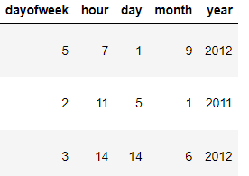
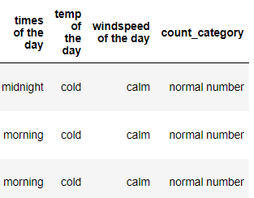
I add new Features to make it easier for EDA and for Modelling.
split datetime to day, dayofweek, hour, month and year.

Slide 8
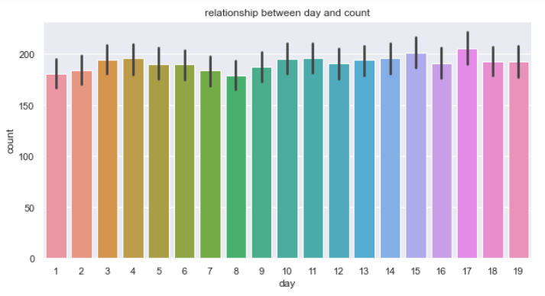
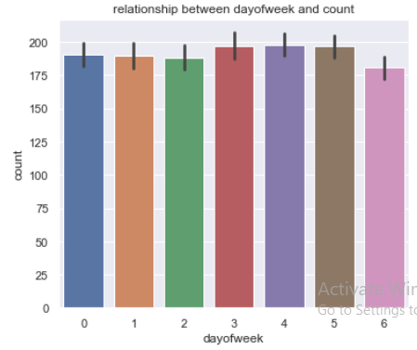
Exploratory Data Analysis
In Which Day of Week and Day of Month that Users rent bikes more ?

Slide 9
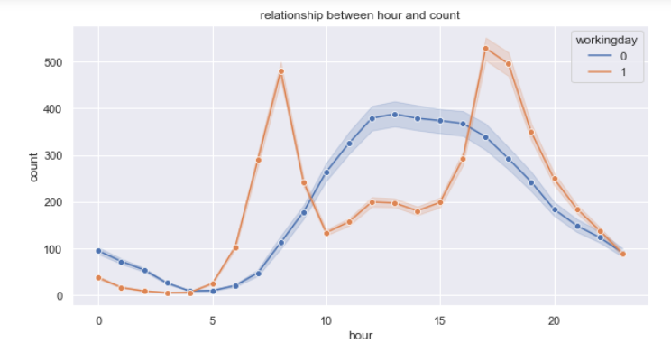
Exploratory Data Analysis
In Which Hour Users rent bikes more ?

Slide 10
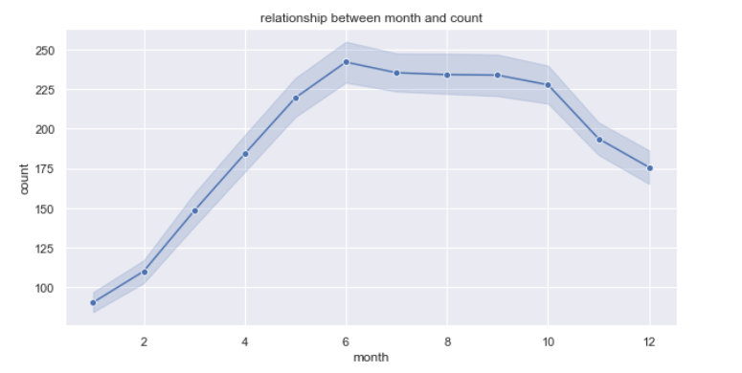
Exploratory Data Analysis
Relationship between month and count of Renting Bikes.

Slide 11
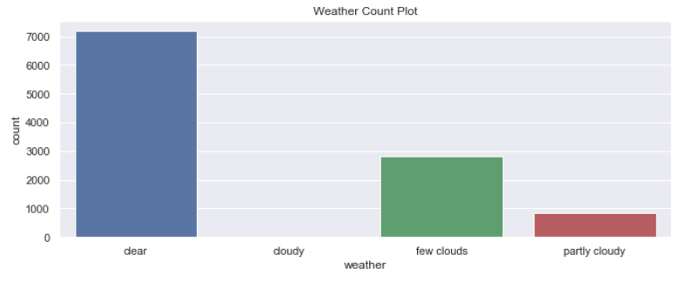
Exploratory Data Analysis
What is the best weather condition in which users rent bicycles ?

Slide 12
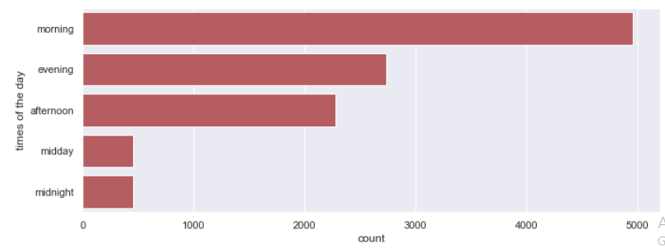
Exploratory Data Analysis
What is the best time of the day in which users rent bicycles?

Slide 13
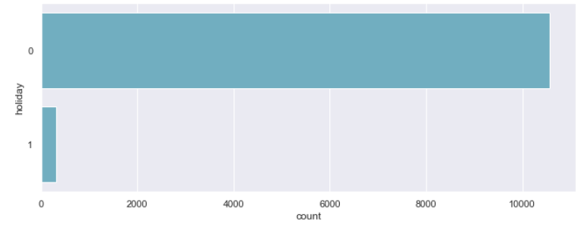
Exploratory Data Analysis
What is the most day type (Holiday or Working Day) in which users rent bicycles ?

Slide 14
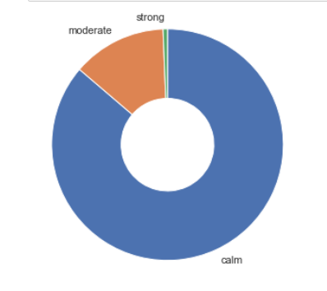
Exploratory Data Analysis
What is the best wind speed state of the day in which users rent bicycles ?

Slide 15
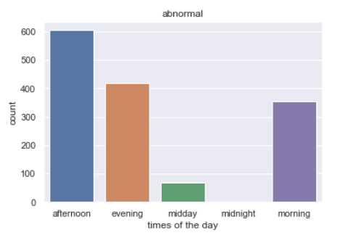
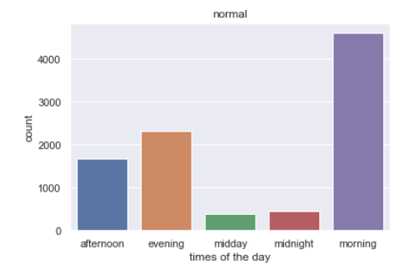
Exploratory Data Analysis
Count of Renting Bicycles is normal and abnormal
Through the day.

Slide 16
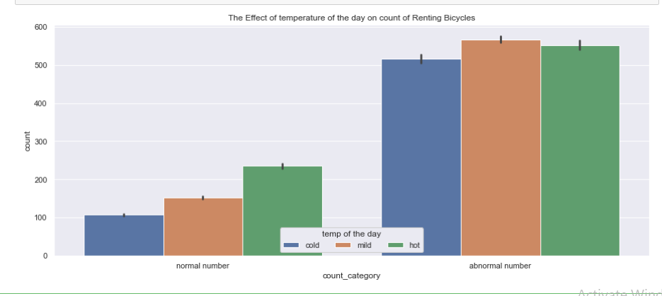
Exploratory Data Analysis
The effect of temperature of the day on count of Renting Bicycles.

Slide 17
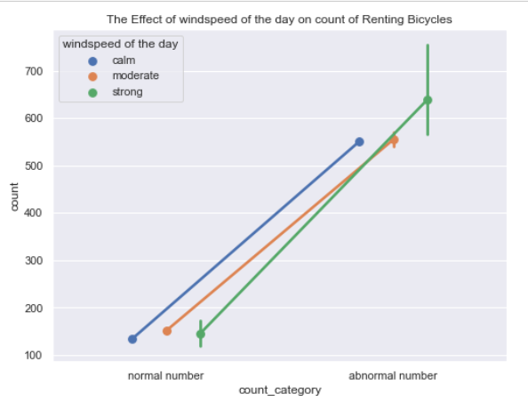
Exploratory Data Analysis
The effect of wind speed of the day on count of Renting Bicycles.

Slide 18
Business solutions and recommendations
1. Bike parking solution for our business.
2. A parking management software to implement initiatives to promote the use of bikes
3. A bonus for the purchase of an electrically assisted bike
4. An encouragement allowance for biking per kilometer
5. Create Bicycle Education Programs

Slide 19
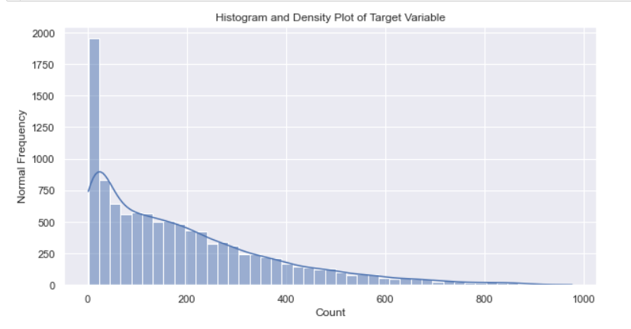
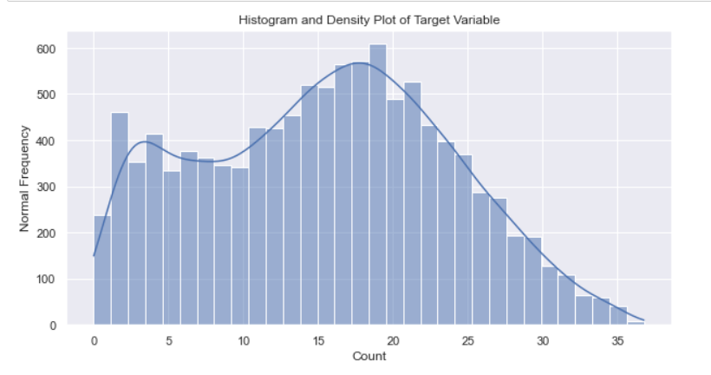
Data Preprocessing - Data Distribution

Slide 20
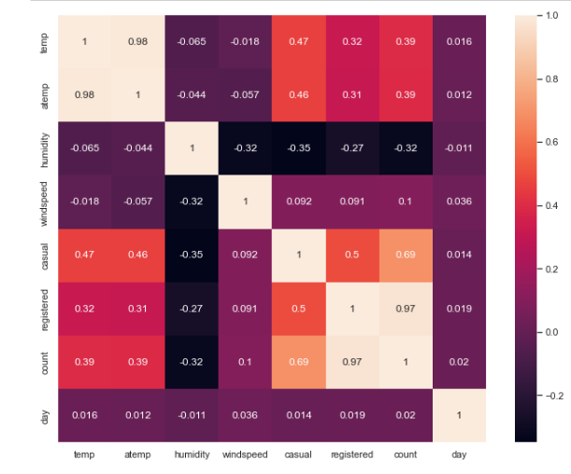
Data Preprocessing - Correlation

Slide 21
Data Preprocessing - Other preprocessing
We also applied Get dummies for category features
We removed unnecessary features and correlated features
We scaled the trained data using Standard Scaler
We split the data into train and test datasets with ratio 75:25

Slide 22
The Challenges
Regression on ‘count’ to predict count of renting bikes

Slide 23
Regression Challenge
We used these models:
1. Linear regression
2. Ridge regression
3. Lasso regression
4. Random Forest Regressor
5. Gradient Boosting Regressor

Slide 24
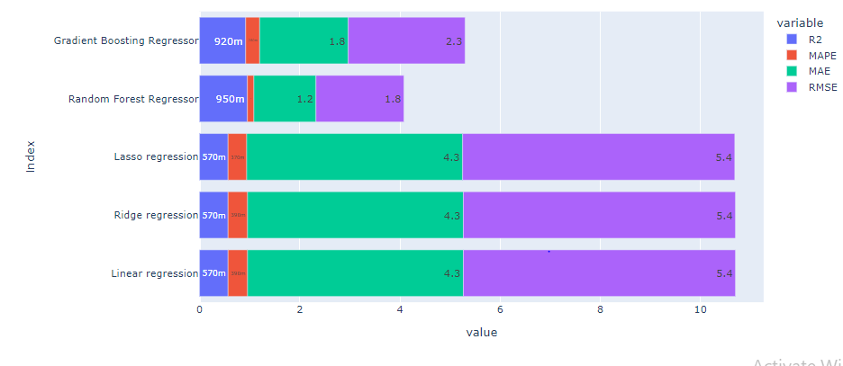
Regression Challenge
We achieved these results:
Based on the results, RF and GB are the best regression models for this challenge

Slide 25
Special Thanks for:
Dr. Doaa Mahmoud
Eng. Mohamed Abdullah

